Slide 1

Application Delivery Fundamentals 2.0 B: Java
Introduction to Open API Swagger

Slide 2
Course Goals / Objectives
At the end of this module, participants will be able to understand:
Swagger
Getting set up to make API Requests
First OpenAPI definitions
Using SwaggerEditor to write OpenAPI definitions
Describing API responses
Creating resources
Adding Authentication and Authorization

Slide 3
Course Goals / Objectives
Preparing and hosting API documentation
Designing a web application
Creating an API design using OpenAPI
Building a change workflow around API Design First
Implementing frontend code and reacting to changes
Building a Backend with Swagger Codegen
Integrating and releasing the web application
The API Design First approach

Slide 4
Swagger
Swagger is an alternative format to API Blueprint for describing your API that you can use in Apiary.
Swagger is open sourced format for describing APIs.
Swagger (Open API) is a language-agnostic specification for describing REST APIs.
It allows both computers and humans to understand the capabilities of a REST API without direct access to the source code.
Its main goals are to:
Minimize the amount of work needed to connect decoupled services.
Reduce the amount of time needed to accurately document a service.

Slide 5
Swagger
Swagger is the tooling ecosystem for developing APIs with the Open API Specification (OAS).
Swagger consists of both open source as well as professional tools, catering to almost every need and use case.
Swagger used to consist of the specification and a large ecosystem of tools to implement the specification.
These tools include everything from front-end user interfaces, low-level code libraries and commercial API management solutions

Slide 6
Swagger
In 2015, Smart Bear Software donated the Swagger specification to the Linux Foundation.
It renamed the specification to the Open API Specification.
Smart Bear also became the founding member of the Open API Initiative (OAI).
It is a body to govern the development of the OAS in an open and transparent manner.

Slide 7
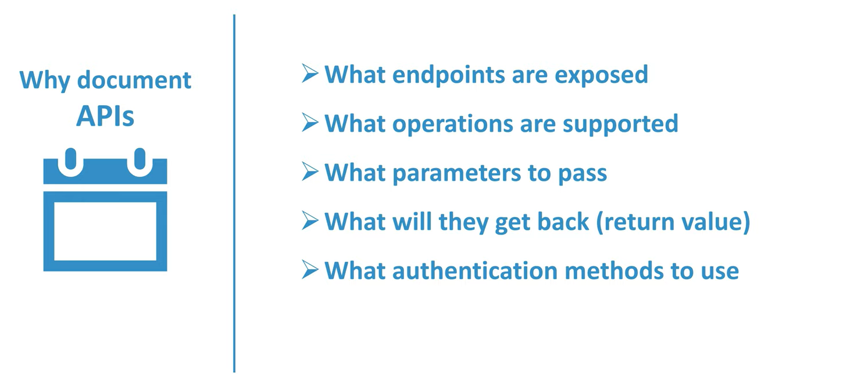
Why Document APIs

Slide 8
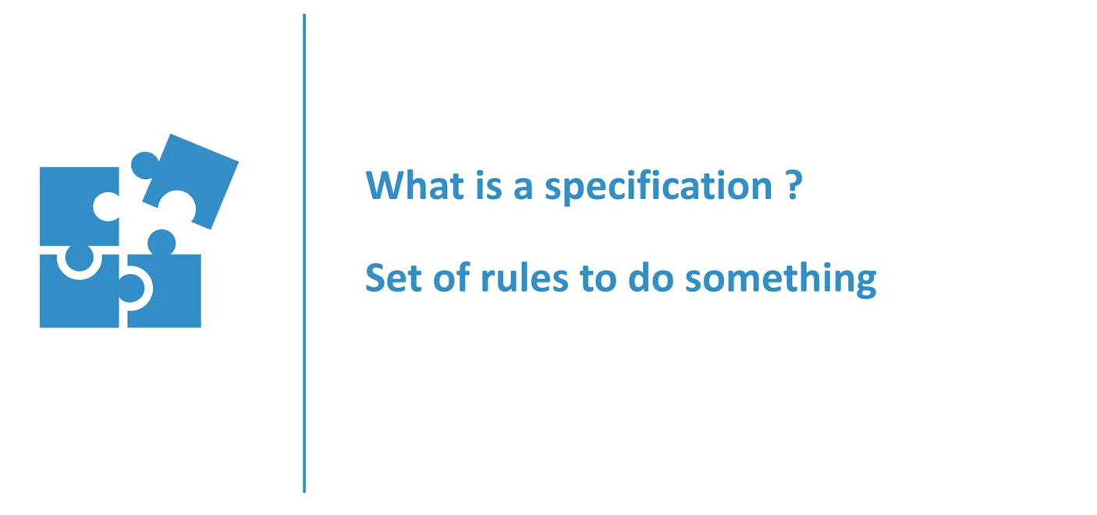
Specification

Slide 9
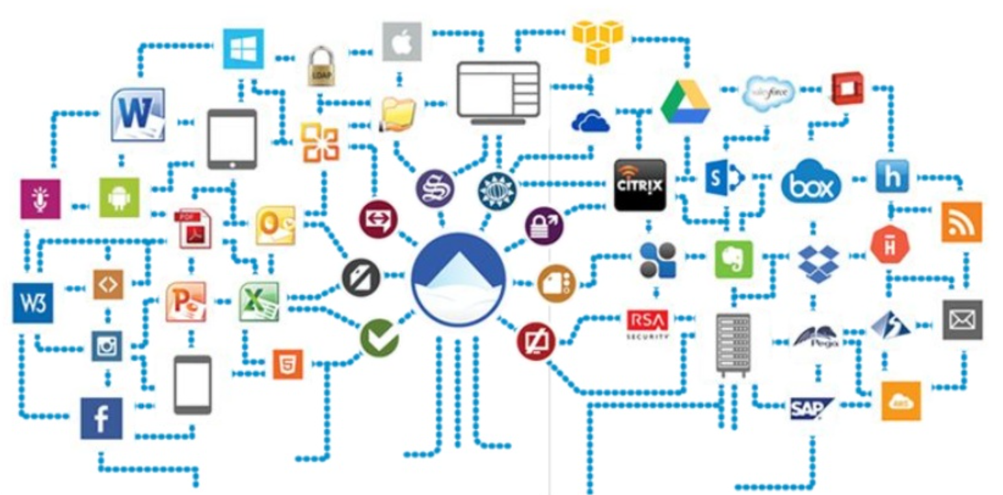
API ecosystem: What’s it all about?

Slide 10
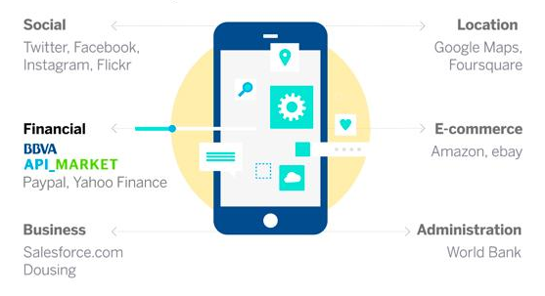
API ecosystem: What’s it all about?

Slide 11
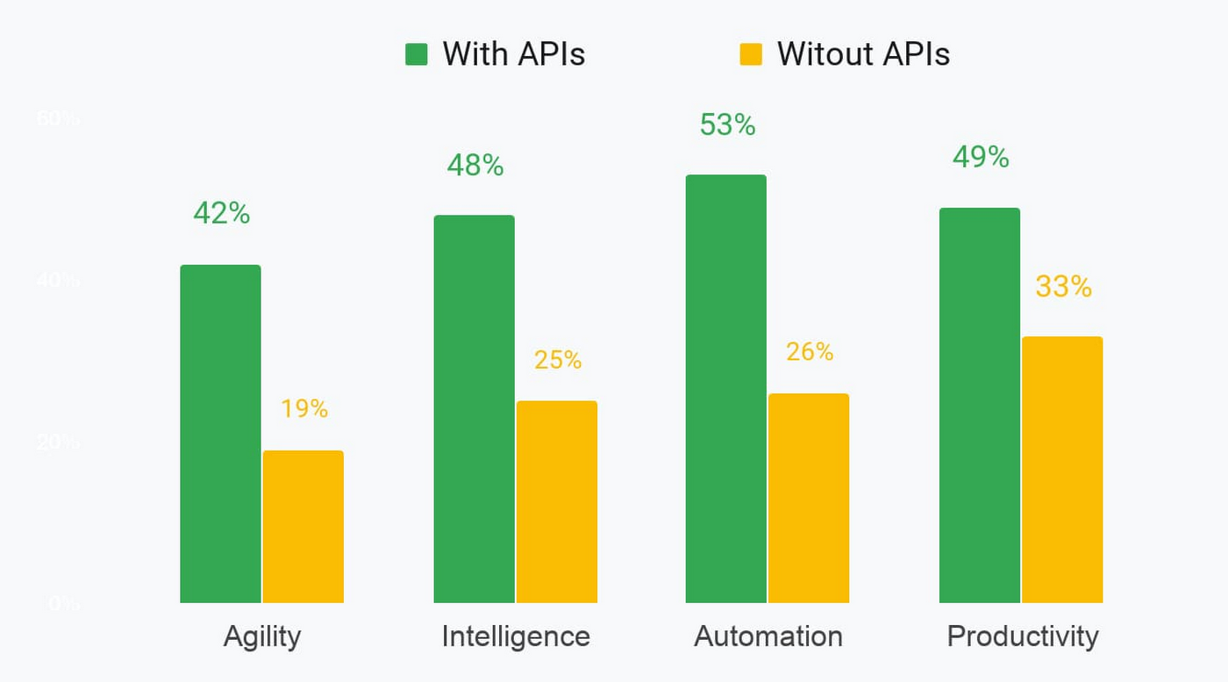
API ecosystem: What’s it all about?

Slide 12
Open API Specification
Enter the Open API Specification (OAS)
The OAS is to REST what WSDL was to SOAP.
It provides a common framework of designers, developers, testers, and devops to build and maintain APIs.
Think of the specification as a set of rules to build and implement a REST API.
The OAS is language agnostic and is both human and machine readable.
It allows both people and computers to discover and understand the capabilities of a service without requiring access to source code, additional documentation, or inspection of network traffic.

Slide 13
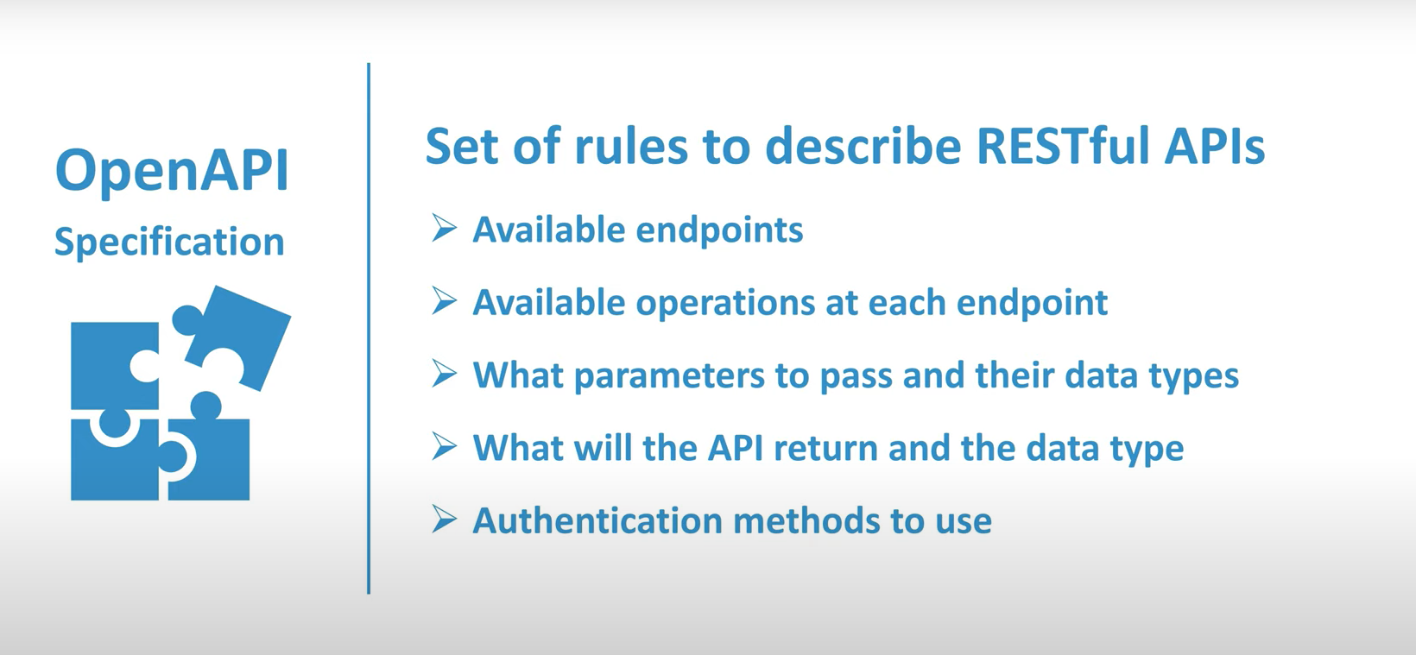
Open API Specification

Slide 14
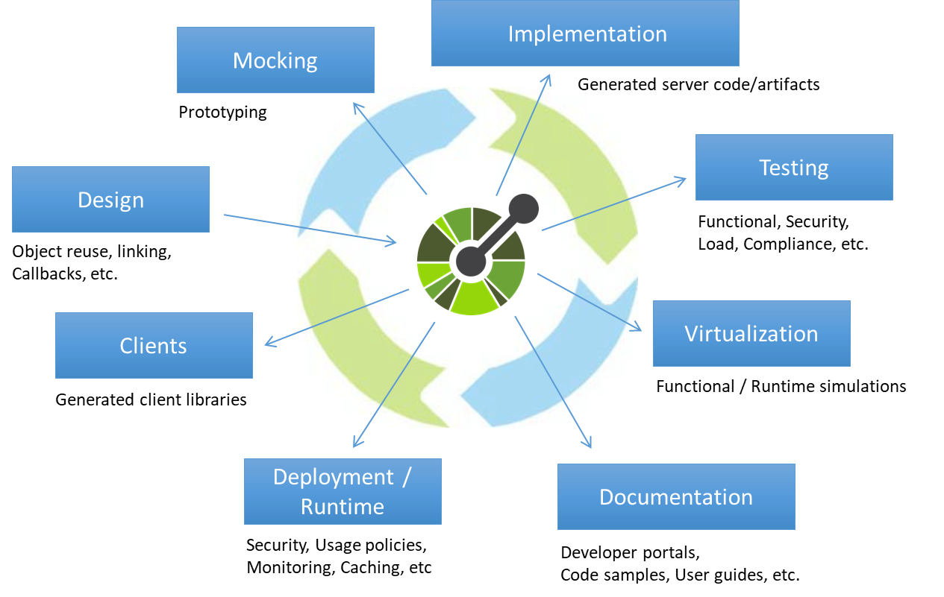
Open API Specification

Slide 15
Swagger vs Open API
The easiest way to understand the difference is:
Open API = Specification
Swagger = Tools for implementing the specification
The development of the specification is fostered by the Open API Initiative, which involves more the 30 organizations from different areas of the tech world — including Microsoft, Google, IBM, and CapitalOne.
Smart bear Software leads the development of the Swagger tools, is also a member of the Open API Initiative, helping lead the evolution of the specification.

Slide 16
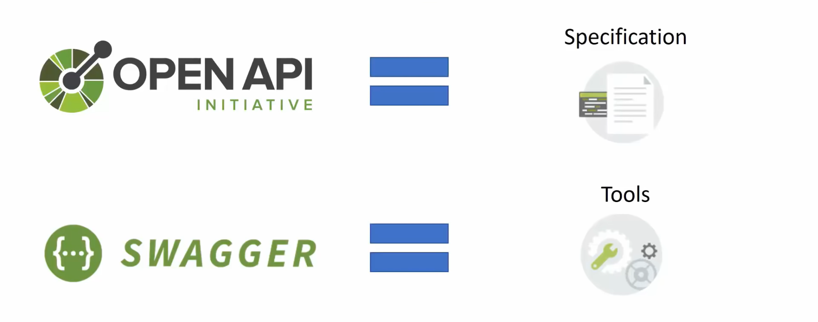
Swagger vs Open API

Slide 17
Swagger vs Open API
Swagger is the name associated with some of the most well-known, and widely used tools for implementing the Open API specification.
The Swagger toolset includes a mix of open source, free, and commercial tools, which can be used at different stages of the API lifecycle.

Slide 18
Swagger vs Open API
These tools include:
Swagger Editor: Swagger Editor lets you edit OpenAPI specifications in YAML inside your browser and to preview documentations in real time.
Swagger UI: Swagger UI is a collection of HTML, Javascript, and CSS assets that dynamically generate beautiful documentation from an OAS-compliant API.
Swagger Codegen: Allows generation of API client libraries (SDK generation), server stubs and documentation automatically given an OpenAPI Spec.
Swagger Parser: Standalone library for parsing OpenAPI definitions from Java

Slide 19
Swagger vs Open API
Swagger Core: Java-related libraries for creating, consuming, and working with OpenAPI definitions
Swagger Inspector (free): API testing tool that lets you validate your APIs & generate OpenAPI definitions from an existing API
Swagger Hub (free and commercial): API design and documentation, built for teams working with OpenAPI.

Slide 20
Where do OpenAPI definitions fit in ?
OpenAPI Specification (formerly Swagger Specification) is an API description format for REST APIs.
An OpenAPI file allows you to describe your entire API, including:
Available endpoints (/users) and operations on each endpoint (GET /users, POST /users)
Operation parameters Input and output for each operation
Authentication methods
Contact information, license, terms of use and other information.

Slide 21
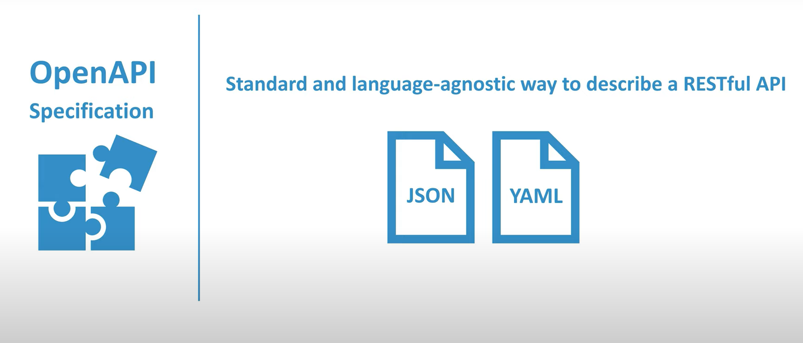
Open API Specification

Slide 22
Where do OpenAPI definitions fit in ?
The ability of APIs to describe their own structure is the root of all awesomeness in OpenAPI.
Once written, an OpenAPI specification and Swagger tools can drive your API development further in various ways:
Design-first users: use Swagger Codegen to generate a server stub for your API. The only thing left is to implement the server logic – and your API is ready to go live!
Use Swagger Codegen to generate client libraries for your API in over 40 languages.
Use Swagger UI to generate interactive API documentation that lets your users try out the API calls directly in the browser.
Use the spec to connect API-related tools to your API. For example, import the spec to SoapUI to create automated tests for your API.

Slide 23
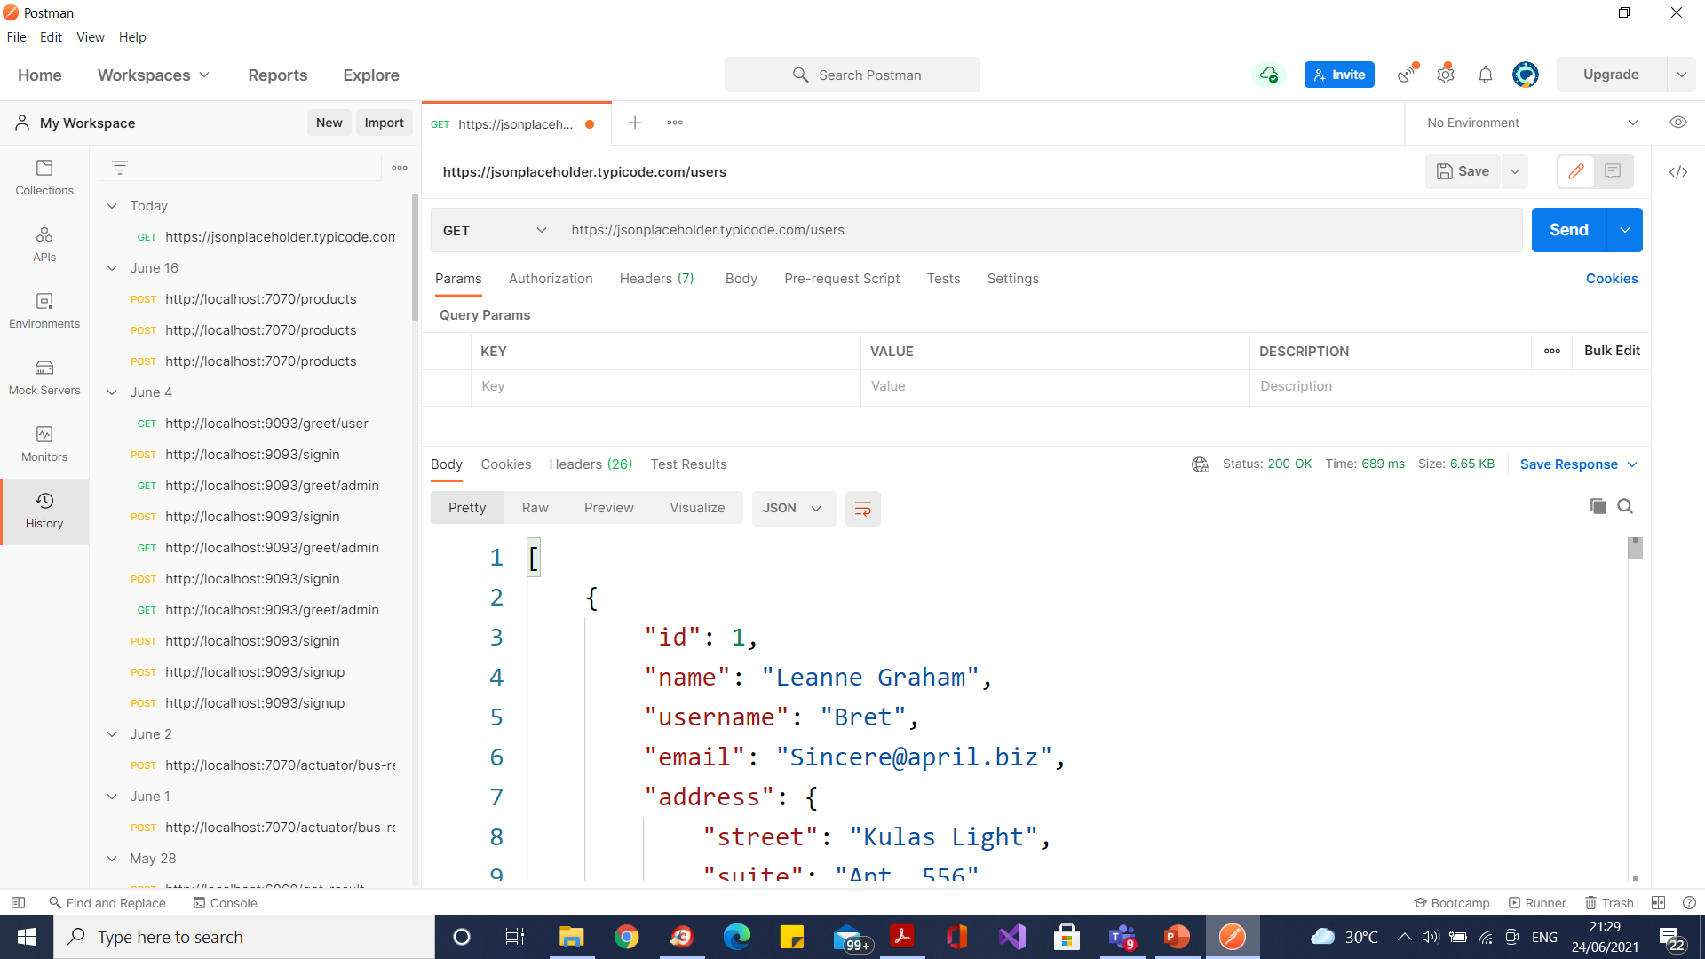
Getting set up to make API Requests

Slide 24
First Open API definitions

Slide 25
The Design-First and API-First Approach
In the “Design-First” approach, write out API design in a human and machine-readable form that all stakeholders can understand, review, and discuss before starting to code.
In API design, “Contract-First” is used interchangeably with Design-First, indicating that the API Designer defines the contract of the API before the implementation is coded.
Applying the design-first / contact-first methodology to the world of API development results in “API-First” development.

Slide 26
The Design-First and API-First Approach
The basic idea is that you create an API contract before doing a full code implementation.
The human-readable API specification becomes the first deliverable, allowing fast feedback from various stakeholders.
Once the team determines that the API specification is “good enough”, the skeleton of a full application can be generated.
Many different programming languages are supported.

Slide 27
The Design-First and API-First Approach
The basic idea is that you create an API contract before doing a full code implementation.
The human-readable API specification becomes the first deliverable, allowing fast feedback from various stakeholders.
Once the team determines that the API specification is “good enough”, the skeleton of a full application can be generated.
Many different programming languages are supported.
For example, a full Spring Boot Application including Maven scripts and JSON-to-Java mapping can be generated.

Slide 28
The Design-First and API-First Approach
The developer codes the business logic implementation in the generated server stub.
As the server-side developer is working on their implementation, consumers of the API can generate client-side stubs and start their implementation work.
QA teams can use the API spec to get a head start on service testing.

Slide 29
The Design-First and API-First Approach
The API-First approach has several advantages:
Design-driven development - API designers use the API design to drive development efforts
Parallel work - Multiple stakeholders work in parallel (API designers, API consumers, technical writers, QA)
API Governance - API teams can use a *contract-as-code approach, versioning and publishing their API specifications
Assisting DevOps - DevOps team can use the API design to test the API before Production deployment
Agility in incorporating changes - API design becomes an ongoing and evolving process, well-supported by automated tooling

Slide 30
API-First Development Workflow
There are 7 high-level steps in the API-First workflow:
Create the API specification
Build API specs at-scale within your organization
Collaborate with stakeholders
Version / Share API spec with other teams
Generate Client/Server scaffolding for Spring Boot
Implement business logic
Deploy the microservice

Slide 31
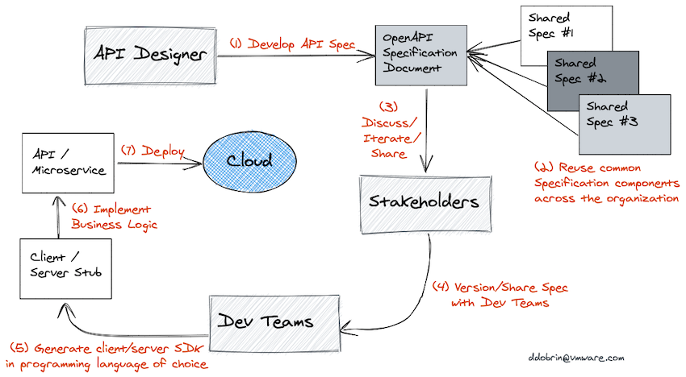
API-First Development Workflow

Slide 32
Step 1: Create the API Specification
Use the OpenAPI 3.0 specification standard and the YAML format to describe the API.
An OpenAPI document has three required sections or objects:
openapi - Semantic version number of the OpenAPI Specification version.
info - Metadata about the API.
paths - Available paths and operations for the API.

Slide 33
Step 1: Create the API Specification
The openapi object states the version of the specification used for the document.
The version is essential for users to understand how the document is structured, and for any tooling which may ingest the document for purposes of validation, or to create virtual services, among other reasons.
The info object provides essential information about the API itself.
The title and version are required fields, and we have the option to include additional information such as a description and contact and licensing information.

Slide 34
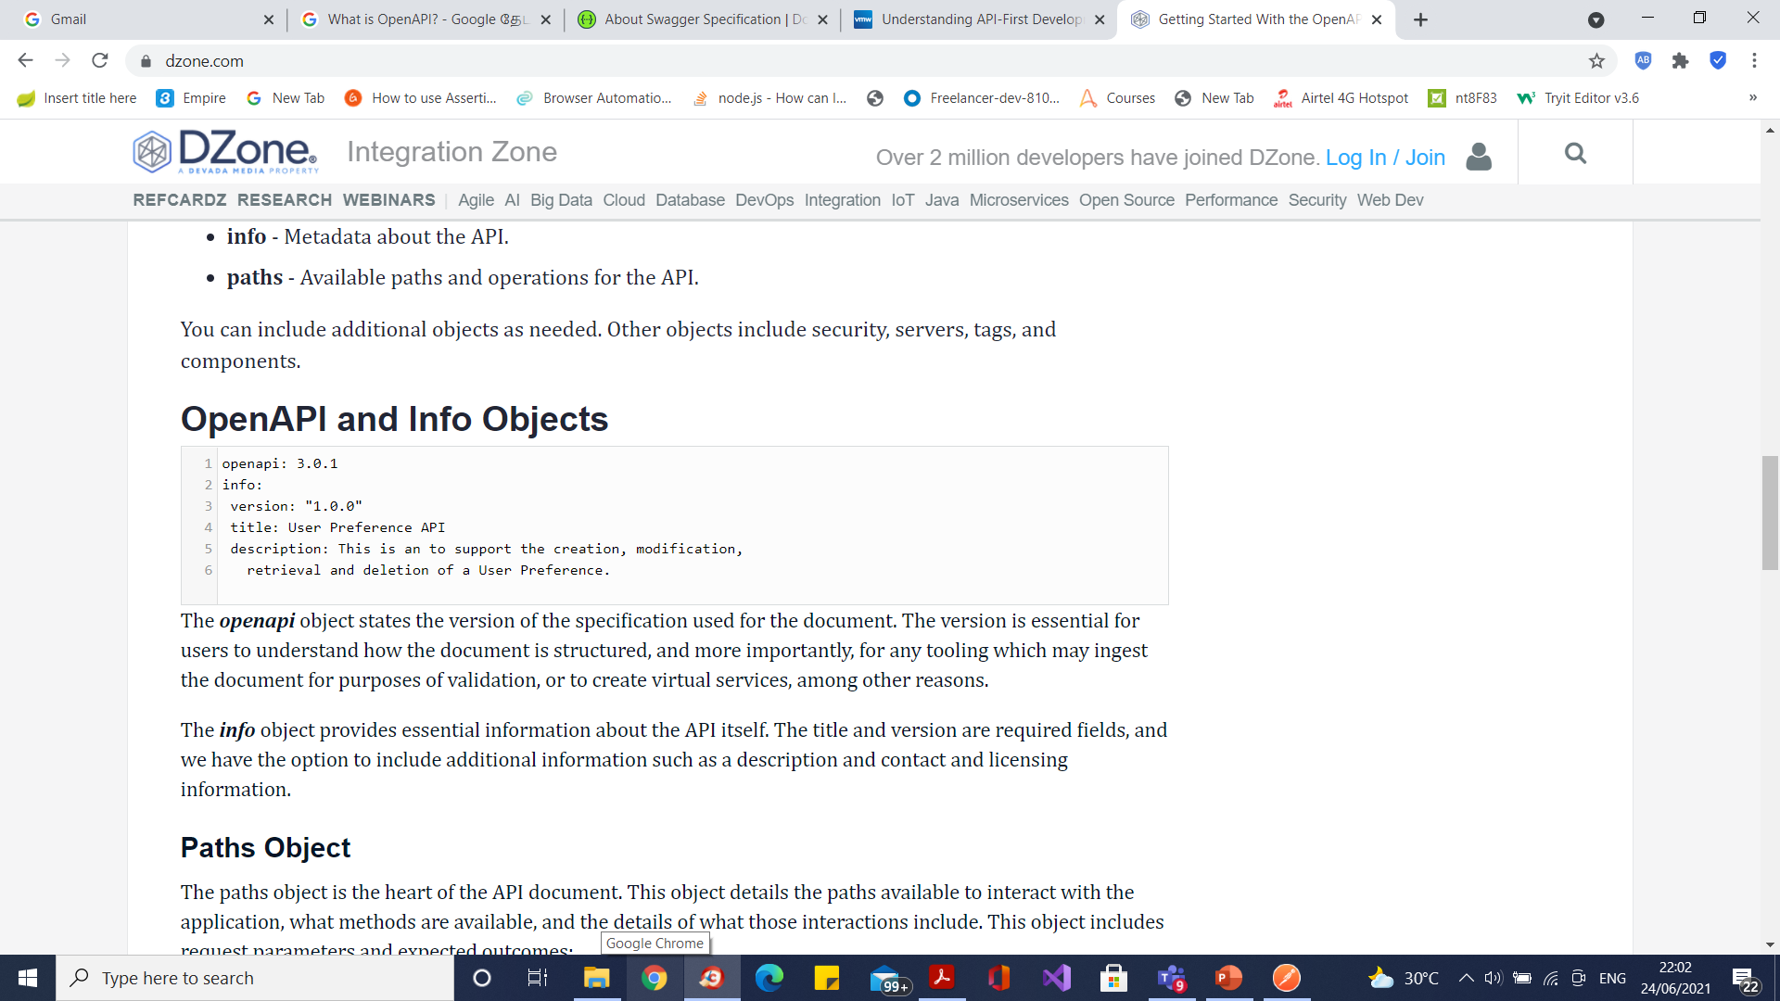
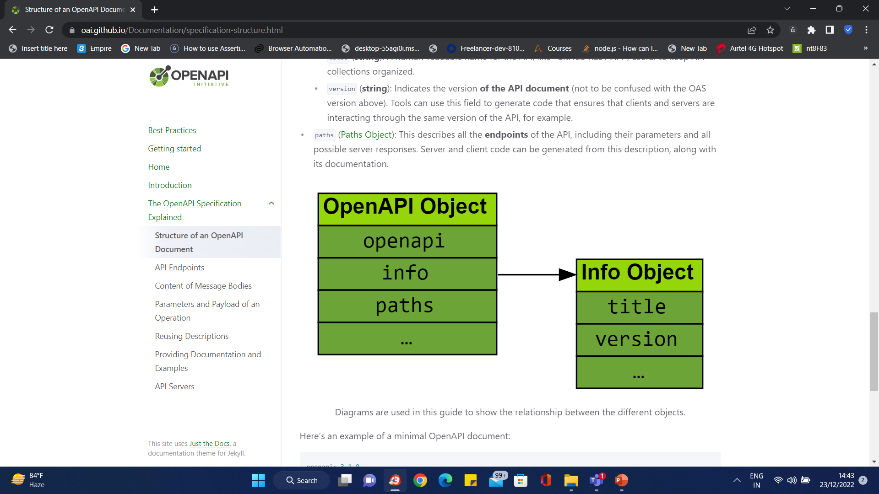
Step 1: Create the API Specification

Slide 35
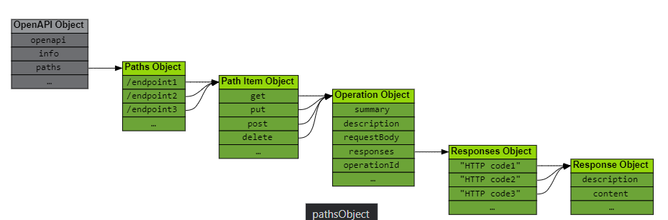
End Points

Slide 36
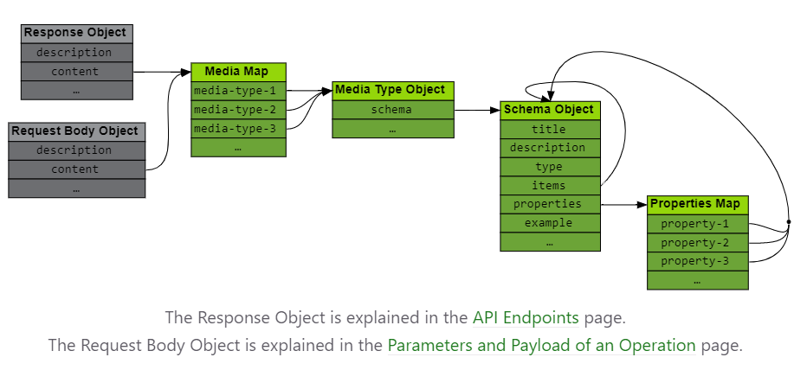
Content of Message Bodies

Slide 37
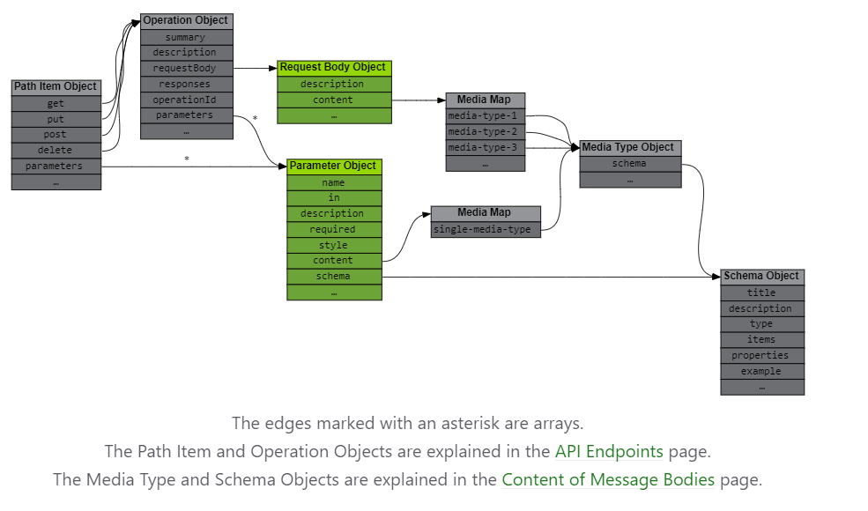
Parameters and Payload of an Operation

Slide 38
Step 1: Create the API Specification
Paths Object
The paths object is the heart of the API document.
This object details the paths available to interact with the application, what methods are available, and the details of what those interactions include.
This object includes request parameters and expected outcomes

Slide 39
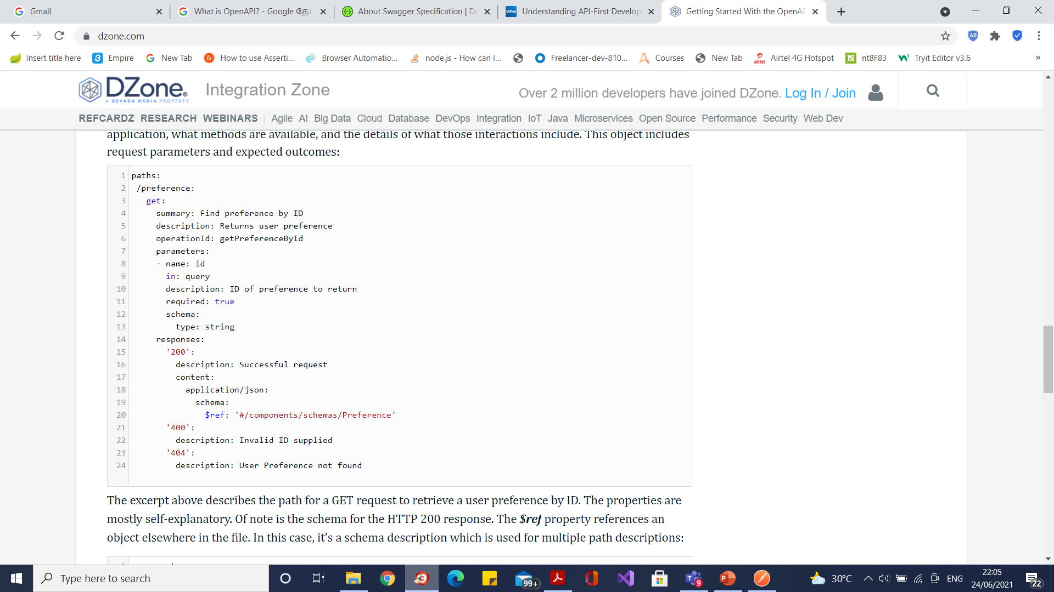
Step 1: Create the API Specification

Slide 40
Media Types
text/plain; charset=utf-8
application/json
application/vnd.github+json
application/vnd.github.v3+json
application/vnd.github.v3.raw+json
application/vnd.github.v3.text+json
application/vnd.github.v3.html+json
application/vnd.github.v3.full+json
application/vnd.github.v3.diff
application/vnd.github.v3.patch

Slide 41
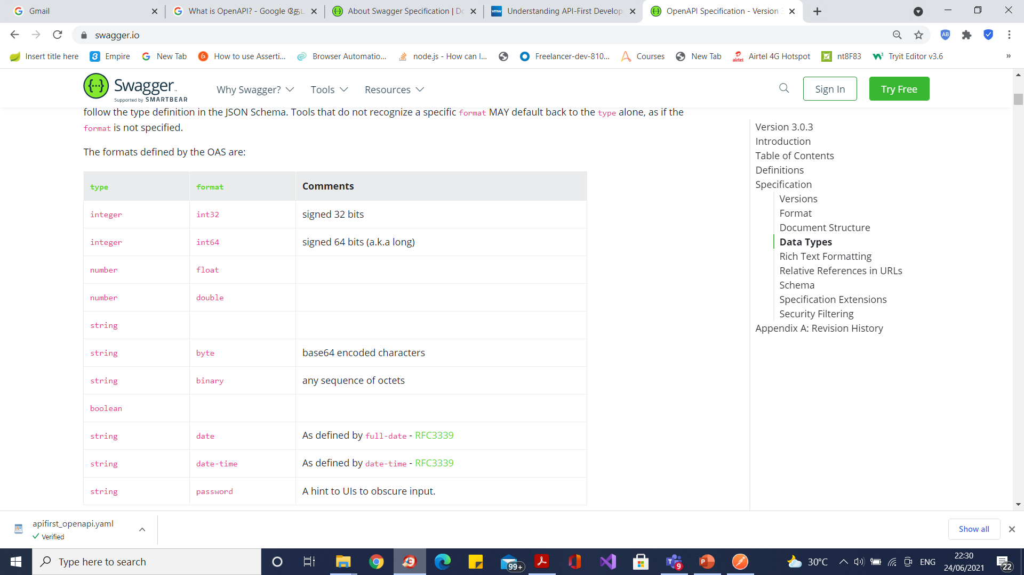
Data Types

Slide 42
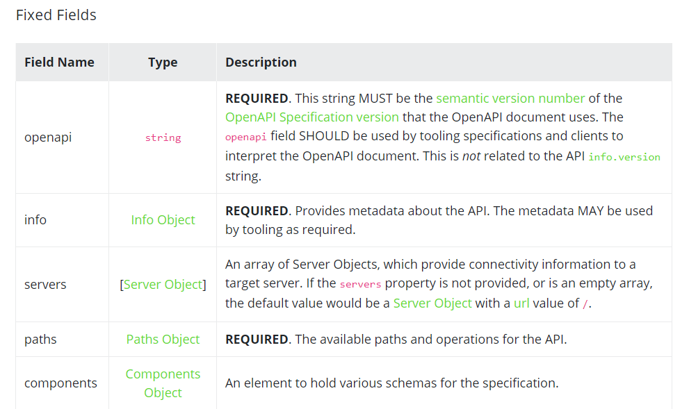
OpenAPI Object

Slide 43
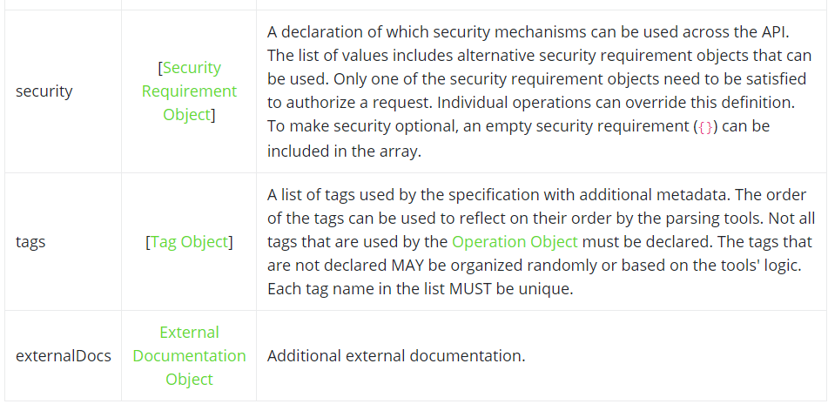
OpenAPI Object

Slide 44
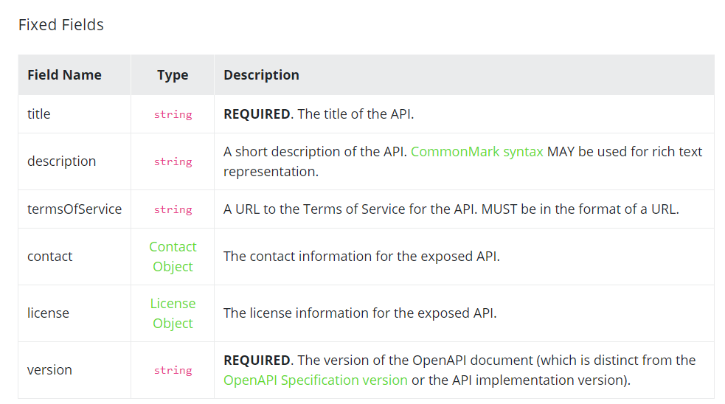
Info Object

Slide 45
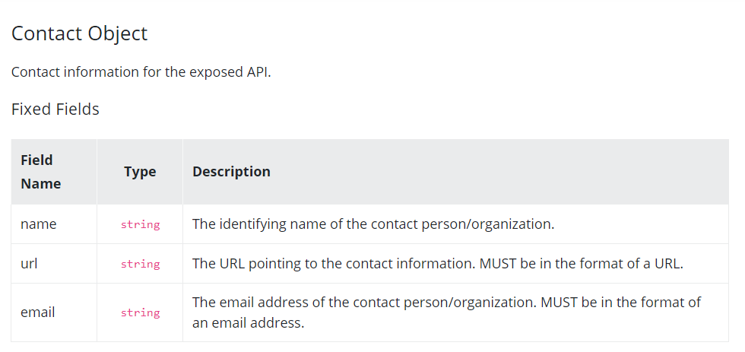
Contact Object

Slide 46
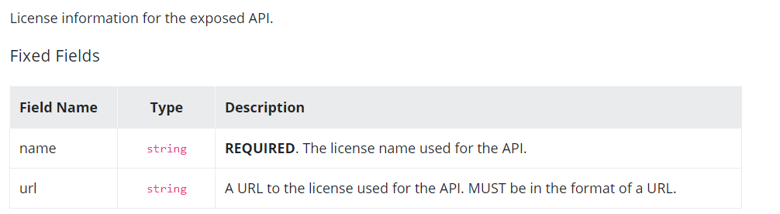
License Object

Slide 47
Create an API
We will be designing an API for a record label.
Let’s assume that the record label has a database of artists with the following information:
Artist name
Artist genre
Number of albums published under the label
Artist username
The API will let consumers obtain the list of artists stored in the database and add a new artist to the database.

Slide 48
Create an API
An API defined using the OpenAPI Specification can be divided into 3 main sections –
Meta information
Path items (endpoints):
Parameters
Request bodies
Responses
Reusable components:
Schemas (data models)
Parameters
Responses
Other components

Slide 49
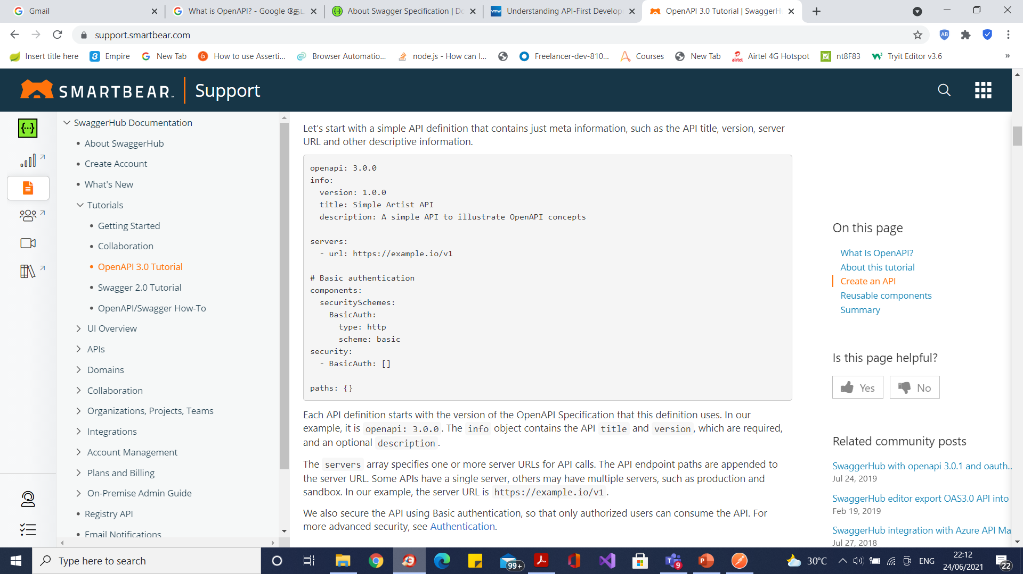
Meta information

Slide 50
Meta information
Each API definition starts with the version of the OpenAPI Specification that this definition uses.
In our example, it is openapi: 3.0.0.
The info object contains the API title and version, which are required, and an optional description.
The servers array specifies one or more server URLs for API calls.
The API endpoint paths are appended to the server URL.
Some APIs have a single server, others may have multiple servers, such as production and sandbox.
In our example, the server URL is https://example.io/v1.

Slide 51
Path items
The path items are the endpoints of your API under which you can specify HTTP verbs for manipulating the resources in the desired manner.
These endpoints are relative to the server URL, which in our example is https://example.io/v1.
We will define the /artists endpoint and the GET method for this endpoint.
So, a client will use GET https://example.io/v1/artists to get a list of artists.

Slide 52
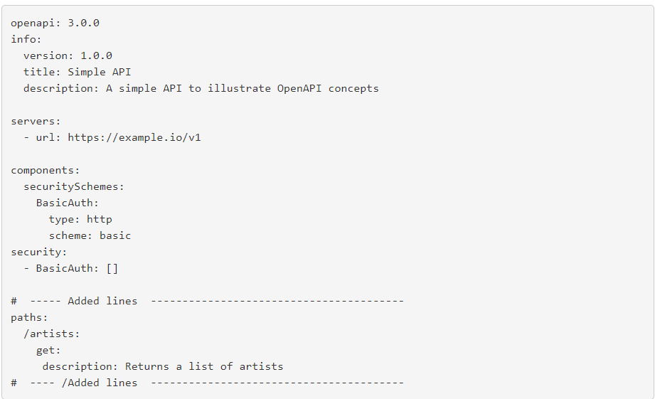
Path items

Slide 53
Responses
The GET method, under the artists endpoint, lets the consumer of the API obtain the details of a list of artists from the https://example.io/v1 database.
Every response would need at least one HTTP status code to describe the kind of responses a consumer is likely to expect.
The description gives details on what the responses of the API would be.
In our sample code, we have specified 200, which is a successful client request, while 400 is an unsuccessful request.
You can find more information about HTTP status codes here.
A successful response will return the artist name, genre, username and albums recorded.
An unsuccessful request is described under the 400 HTTP code, with a corresponding error message detailing why the response is invalid.

Slide 54
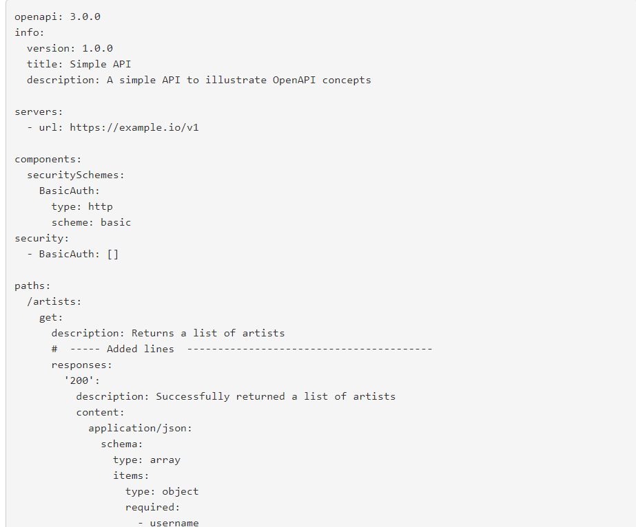
Responses

Slide 55

Responses

Slide 56
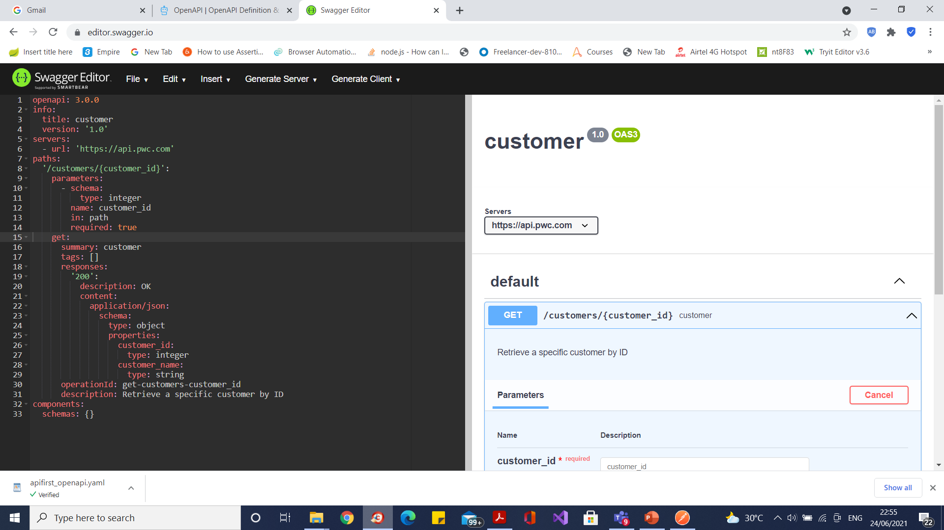
Open API Editor

Slide 57
What OpenAPI Tools Are Available?
Stoplight Studio - a free OpenAPI editor, to easily write API descriptions without memorizing syntax.
Spectral an automated validation tool, helps maintain API consistency and style with customizable OpenAPI linting.
Prism a mock server generator, which builds upon your OpenAPI definition to prototype or run integration tests.

Slide 58
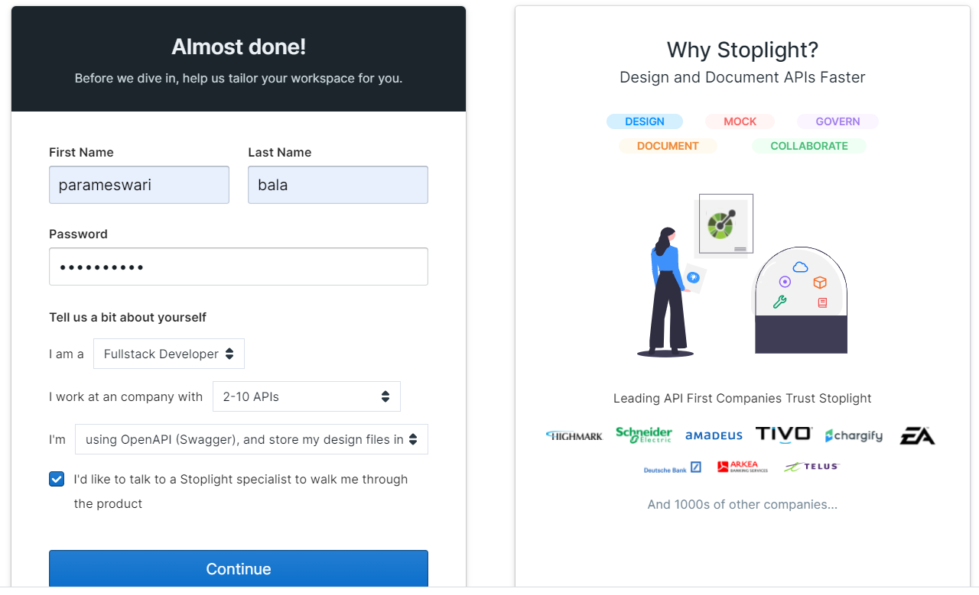
Stoplight
https://veb-consulting.stoplight.io/welcome/account

Slide 59
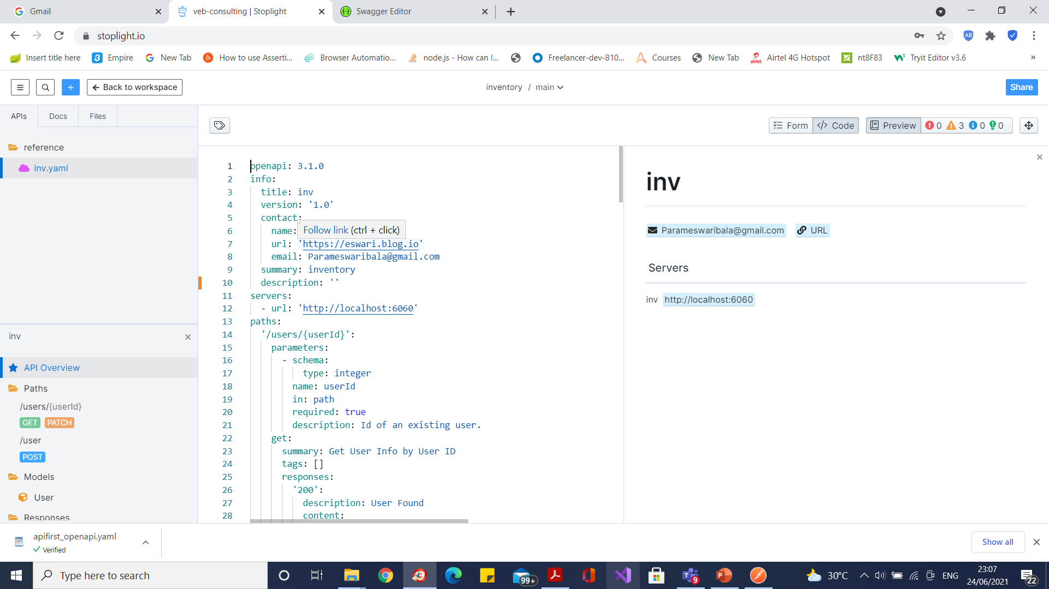
Stoplight

Slide 60
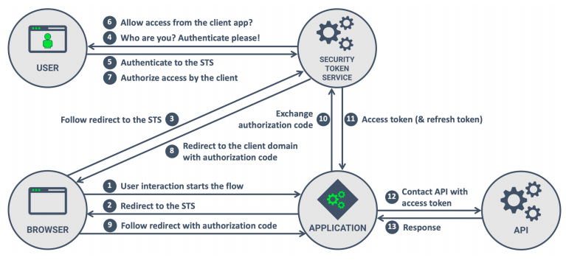
Oauth Authentication

Slide 61
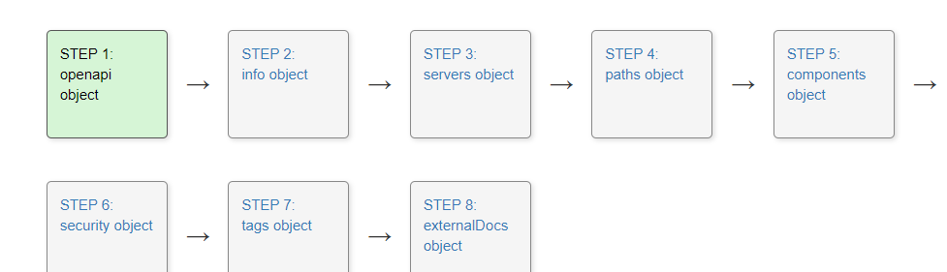
API-First Development Workflow

Slide 62
Which security scheme?
API key
HTTP
OAuth 2.0
Open ID Connect

Slide 63
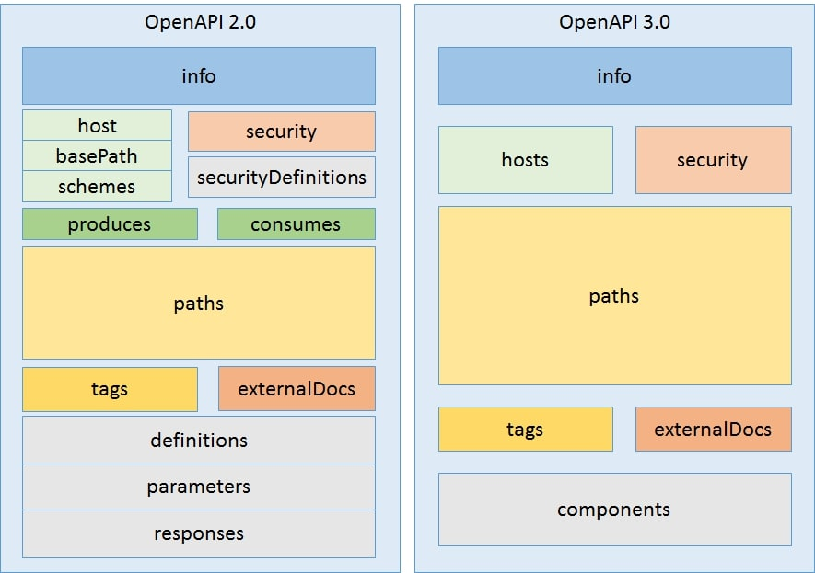
Open API 2.0 vs 3.0

Slide 64
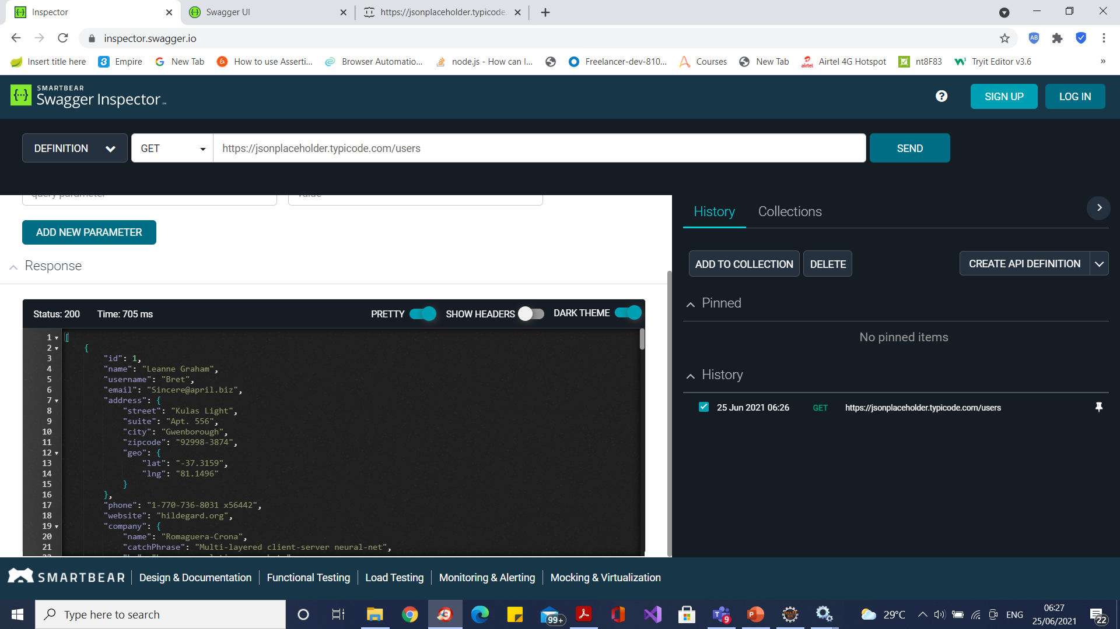
Swagger Inspector

Slide 65
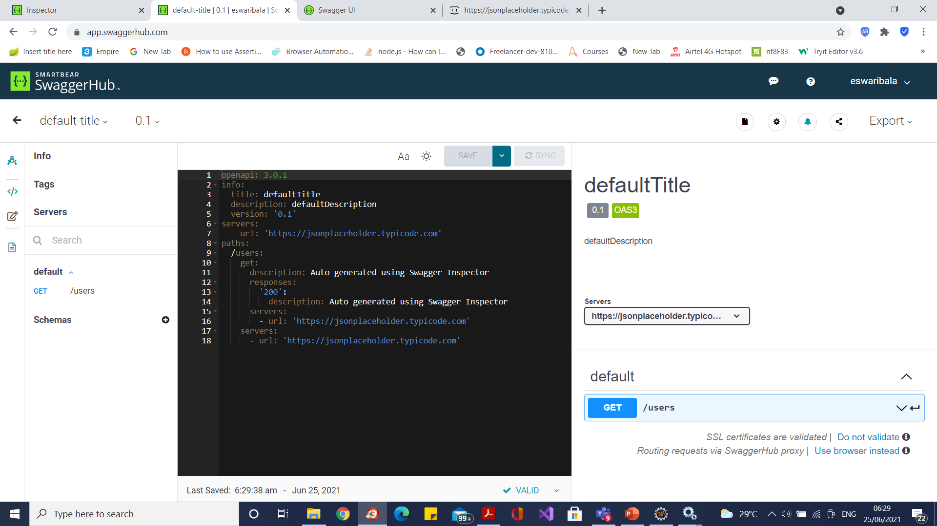
Swagger Inspector

Slide 66
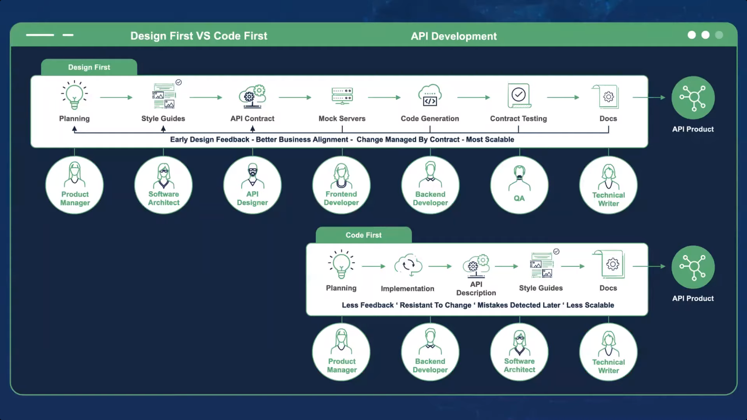
API Workflow

Slide 67
Questions

Slide 68
Module Summary
In this module we discussed
Overview of Maven
Maven archetypes
Maven life cycle phases
The pom.xml file
Creation of Java projects using Maven
Creation of war files

